Slide 1
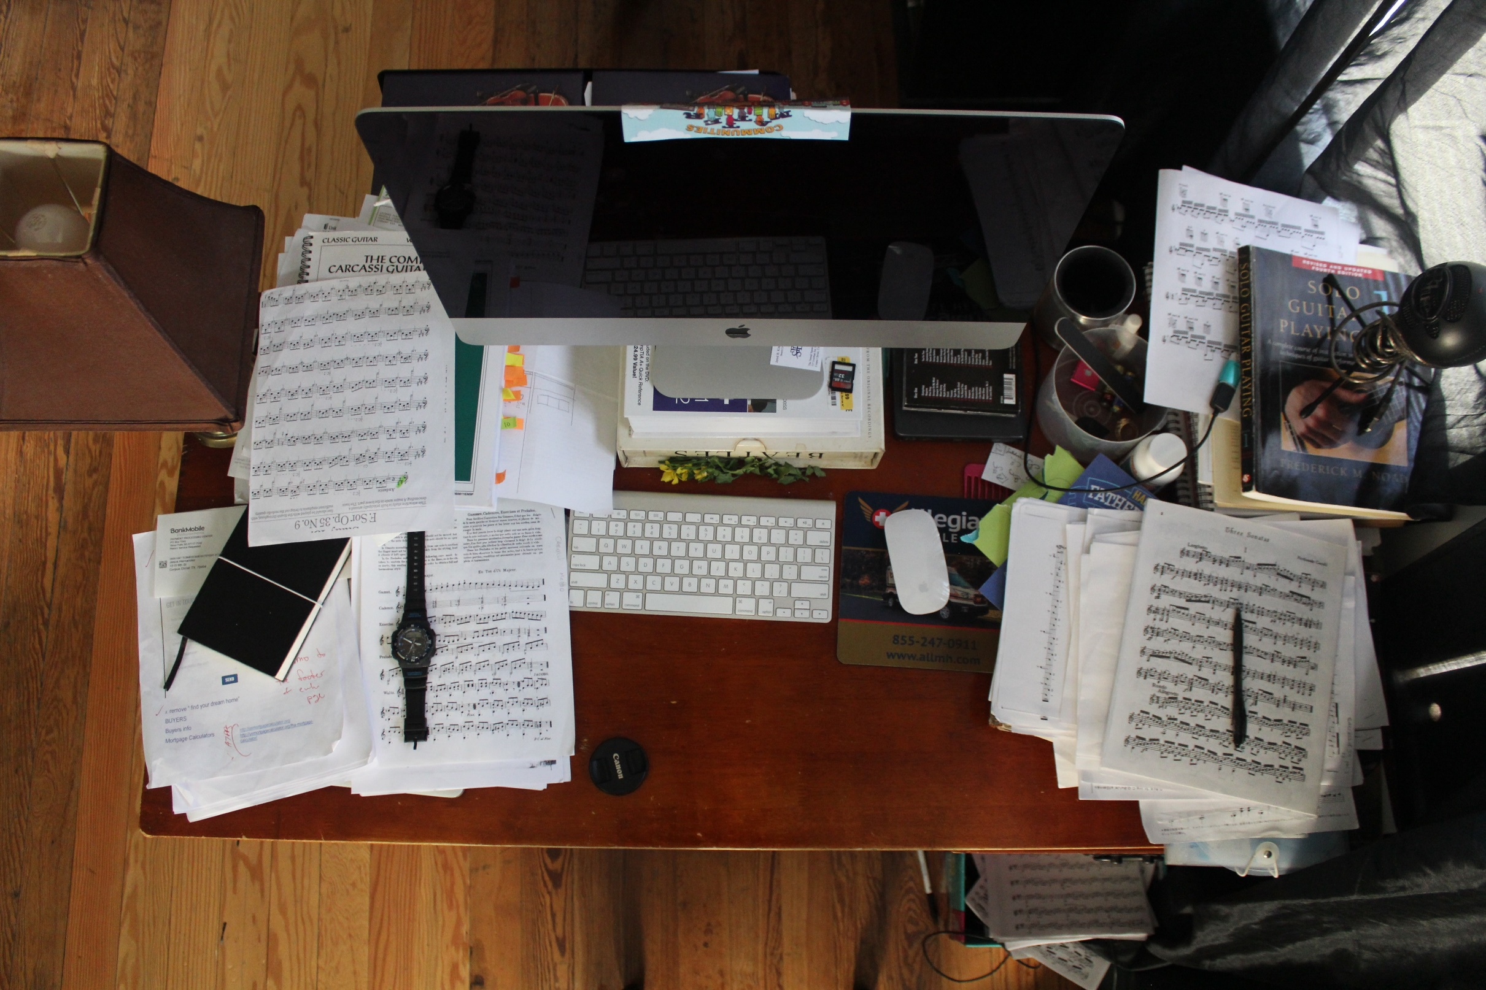
Business Intelligence using Microsoft SQL Server & Power BI

Slide 2

What is Business Intelligence

Slide 3
What is Business Intelligence
Business Intelligence
Relevant and Reliable information
at the right time
better business decisions
Decision Support Systems

Slide 4
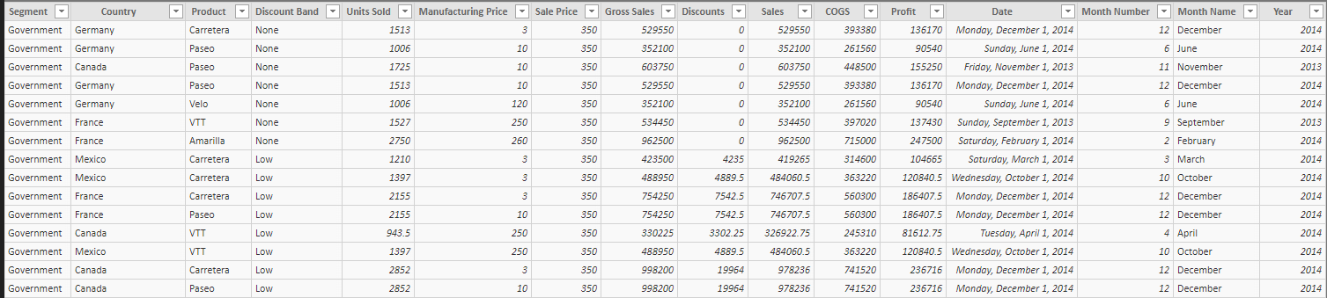




What is Business Intelligence

Slide 5
What is Business Intelligence
BI=
Understand or even predict an individual customer
Segments
Needs
Preferences
Habits

Slide 6
What is Business Intelligence
BI→
New opportunities to sell
Better Service
Target marketing campaigns

Slide 7
What is Business Intelligence
Increase revenue
Better faster decisions
BI→
Improve customer satisfaction
Reduce IT count head
Reduce cost
Improve budgets
Optimize ROI on operations
and much much more …

Slide 8
Why use Business Intelligence
1. Accelerating and improving decision making
2. Optimizing internal business processes
3. Getting to know about business’ past, present and future.
4. Increasing operational efficiency
5. Giving quicker responses to business-related queries.

Slide 9
Why use Business Intelligence
6. No more guess work
7. Meeting/Exceeding Manufacturing & Inventory Goals
8. Gaining valuable insight into customer’s behavior
Improved : data quality, employee satisfaction, customer satisfaction, Increased Revenue, Reduce Cost, Better, faster decisions, Reduced IT head count, Reduced external IT costs, Reduced non-IT costs, Expansion of types of analysis, Availability of better insights to more people, Monetization of data etc…

Slide 10
What BI can do for business
Retail :
Increasing Margins
Optimizing Pricing
Optimizing Promotions
Increasing Customer Satisfaction
Improve Inventories
Improve Sales
Improve Marketing Strategies
Personalizing Offers
ROI in IT and other costs
(Report Automation = RIO of 188%, Tactical Decisions = ROI of 389%, Strategic BI Decisions = ROI of 968%)

Slide 11
What BI can do for business
Supply chain Management :
Forecasting
Better Inventory Status
Improve Demand Planning
Improve Sourcing / Procurements
Improve Production
Improve HR Productivity
Improve Transportation

Slide 12

What BI can do for business
Sales and Marketing :
What items not sold well
Better Inventory Status
Optimal Sales force size
Competitor sales analysis
What initiatives performing better today
Which of them viable in the long run
What can learn from our competition
Are we using the right channels

Slide 13
What BI can do for business
Human Resource Management :
Talent acquisition and Retention
Know Attrition
Improve Headcount Management
Optimization Workforce
Optimization Compensation and Benefits
Performance and Career Management optimization
Improve Training and Develop
Can also be used in Manufacturing, Finance etc…

Slide 14
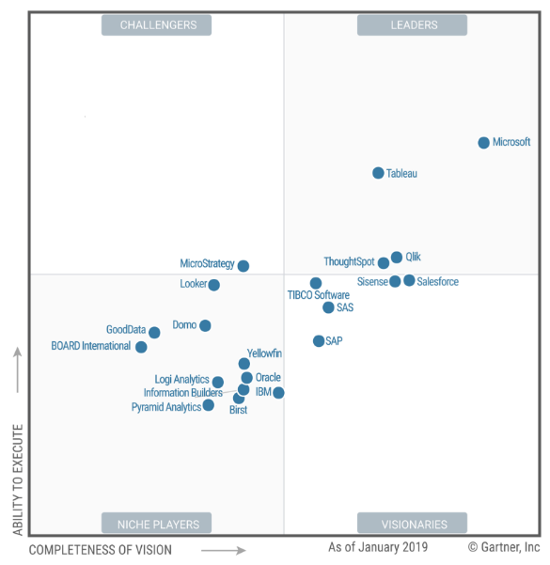

Characteristics of Modern BI Tools
Needed to have capabilities like : | Power BI
Cloud BI
Data connectivity and ingestion
Data loading choices
Data preparation
Scalability
Analytics for citizen data scientists
Interactive Data Visualizations
Augmented information discovery
Embedding of analytic contents
Publish, share and collaborate
Workflow Collaboration
Ease of use
Customer Service / Support options
https://info.microsoft.com/ww-landing-gartner-mq-bi-analytics-2019.html?LCID=EN-US

Slide 15
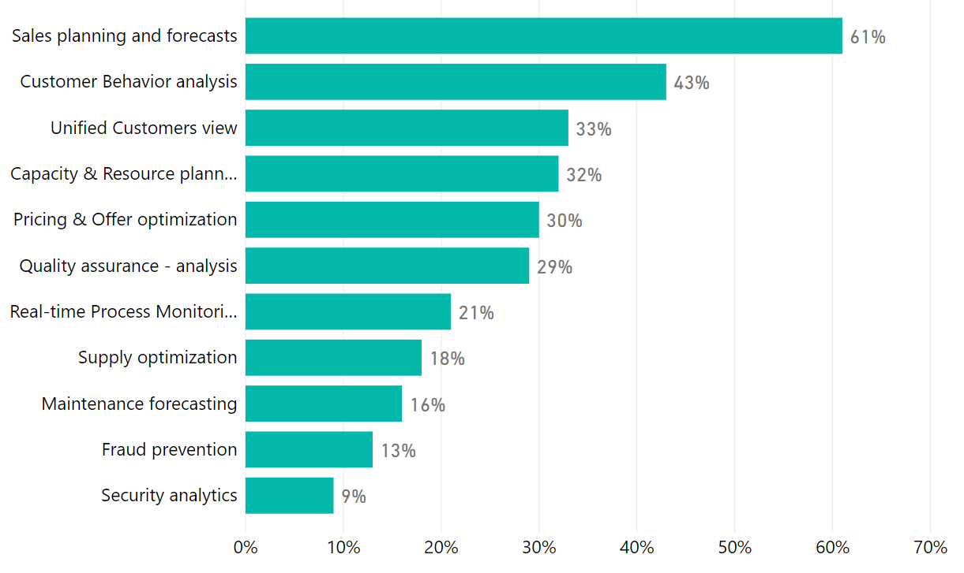
How companies are using BI

Slide 16
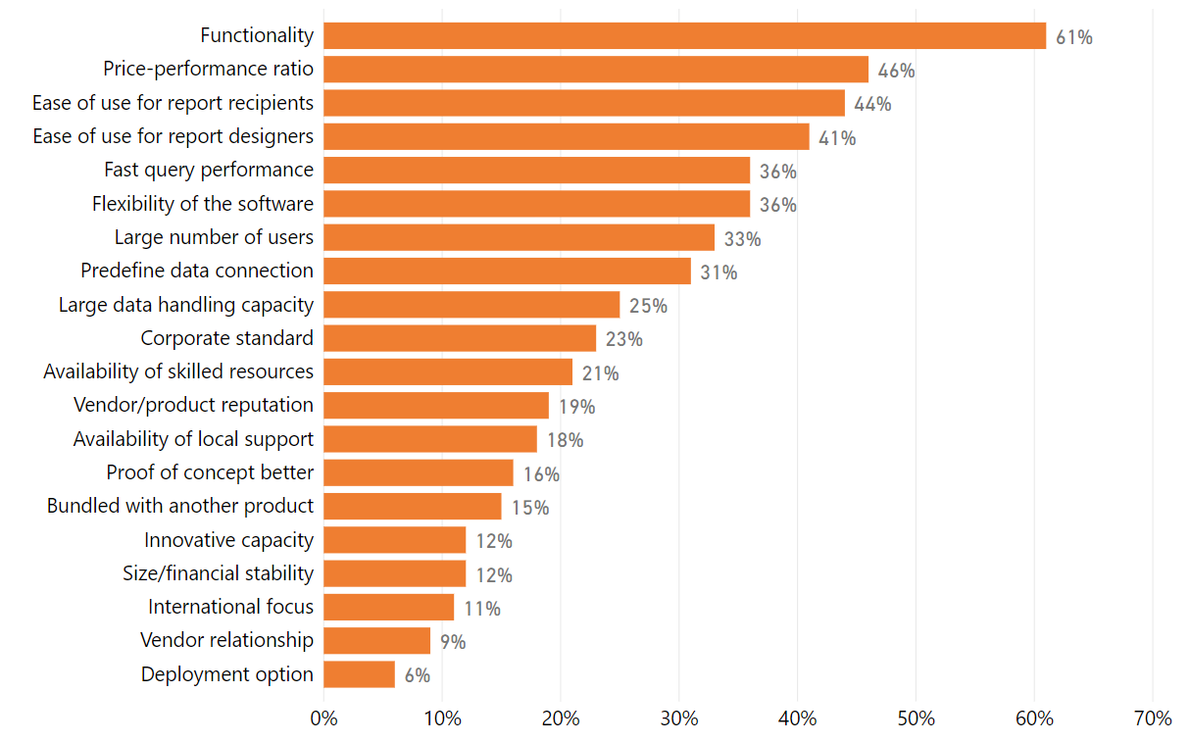
Factors to consider while buying

